Slide 1
Workers’ Compensation, Auto Accidents & Drug Testing: An Overview for New Supervisors and Employees
By Michael Bennett, Risk manager and Kevin Vaughn, Safety Coordinator

Slide 2
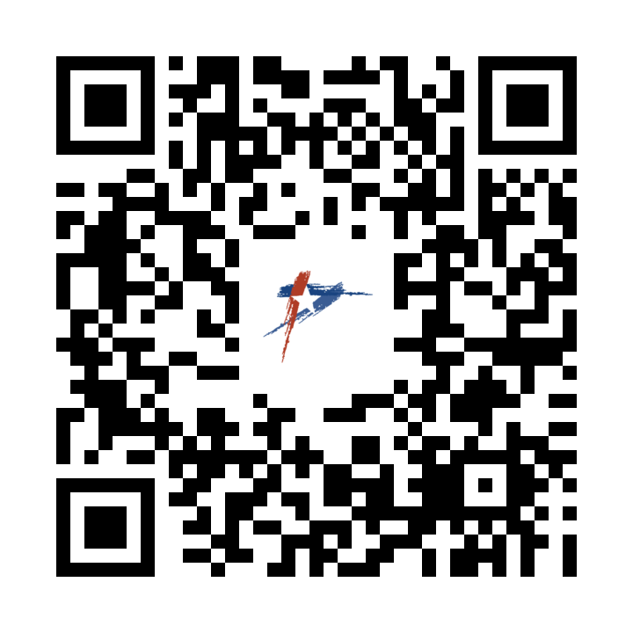
Every Risk Management Policy and Form can be Found with this QR Code
Safety & Risk Management | Round Rock EmployeeNet (roundrocktexas.gov)

Slide 3
Objective:
Risk Management Webpage
Work related injuries rights and processes
Automobile Accidents-What you should do when an employee is involved in an accident
Drug and Alcohol Testing-When it’s required, how to complete and when employees can return to work

Slide 4
Safety Rules and Work Procedures
A safe workplace must have safety guidelines and these guidelines will always be followed! The City’s safety rules are listed in the below documents:
City’s Safety Manual- Covers administrative policies and general safety guidelines
Departments Risk Management Plans-Provides you with specific safety rules, policies and procedures pertaining to the hazards in your Departments

Slide 5
Incident Reporting

Slide 6
Accident Reporting
All accidents/incidents must be reported using the City of Round Rock incident report form which is available on the Employee Net. This completed form will be forwarded to Safety/Risk Management and will be used by staff to assist in eliminating hazards and preventing similar accidents/ incidents. Incident reports will sent to _RiskManagement@Roundrocktexas.gov email address.

Slide 7
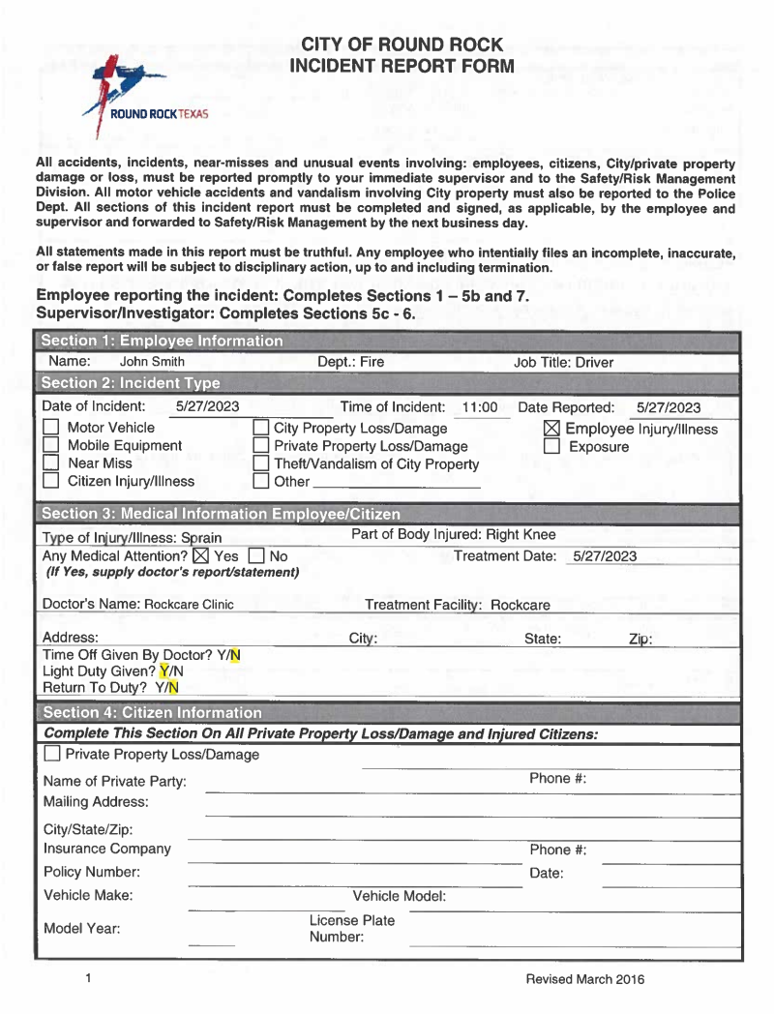
Employee completes all but 5(c-e)

Slide 8
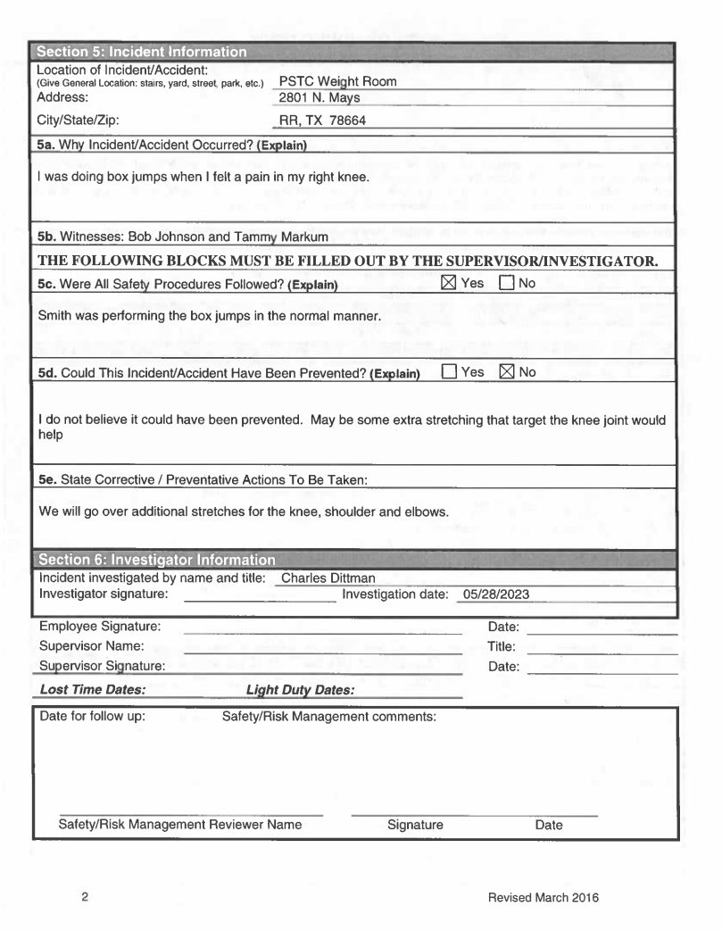
Supervisor completes 5 (c-e)
Make sure everyone signs

Slide 9
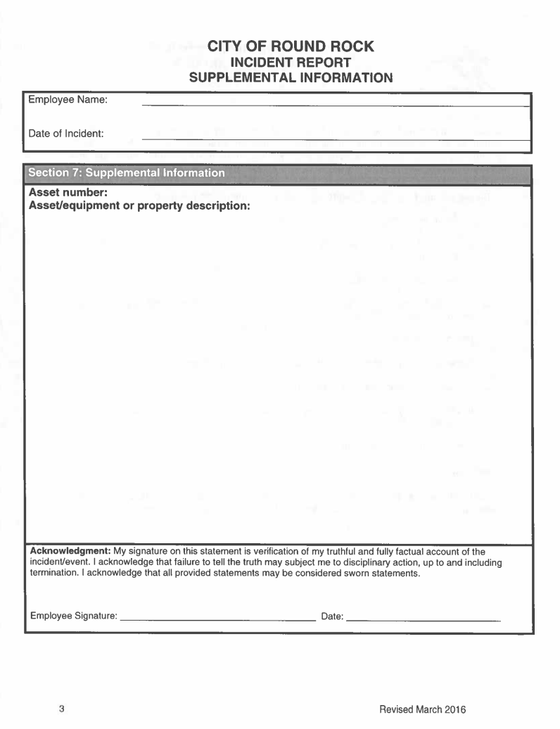
May be used for additional information

Slide 10
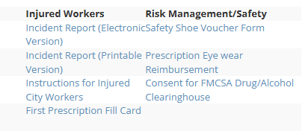
Electronic Filing

Slide 11
Work Related Injury
Was anyone hurt?
  Does the injured worker want or need medical treatment?
  Seek medical care if necessary; emergency or urgent care
Tell someone!
  Report all accidents immediately to Supervisor
  Accidents requiring medical treatment must be reported to Safety/Risk Management immediately!
  All other accidents shall be reported by the next business day to Safety/Risk Management on an incident form
Notes:
Was anyone Hurt?
Take care of any necessary medical or first aid treatment first
Tell Someone:
All incidents shall be reported directly to the appropriate supervisor immediately
Any serious incident or an incident requiring medical treatment shall be reported to Risk Management immediately
All other incidents shall be reported with in 24 hours
Reporting the Incident:
Employee:
Must complete an incident report
Supervisor :
Investigates the incident
If employee can’t complete the report, the supervisor is required to do a preliminary report

Slide 12
Seeking Medical Treatment For An On-The-Job Injury?
Emergency medical care can be obtained from any hospital emergency room
For non-emergency injuries, care must be obtained at the City’s RockCare clinic.
After hours care can be attained at any urgent care clinic. CareNow is preferred
Employee must go to Rockcare the next business day
Follow-up medical treatment must be obtained by doctors contracted with the Workers’ Compensation network of providers

Slide 13
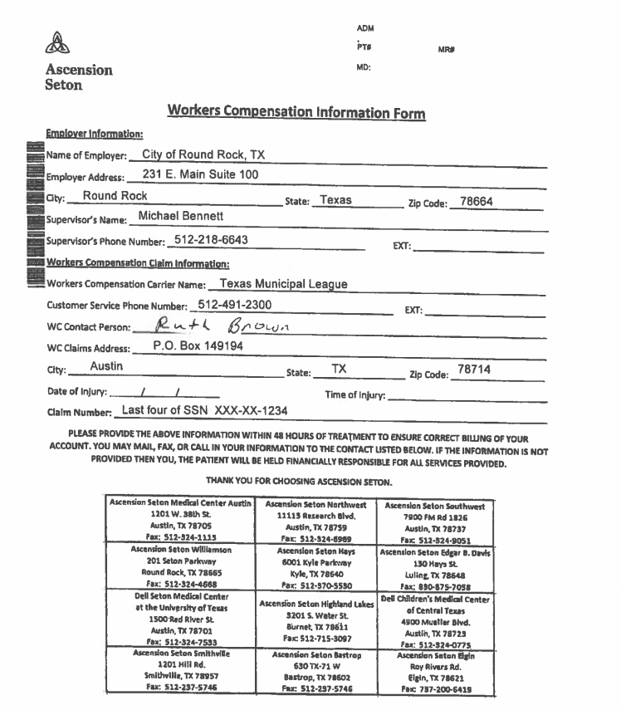
Ascension Seton ER

Slide 14
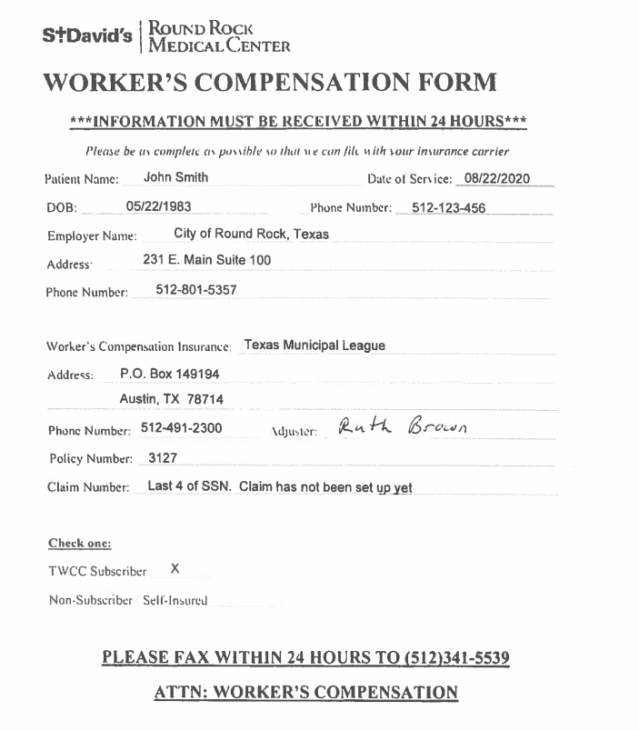
St. David’s ER

Slide 15
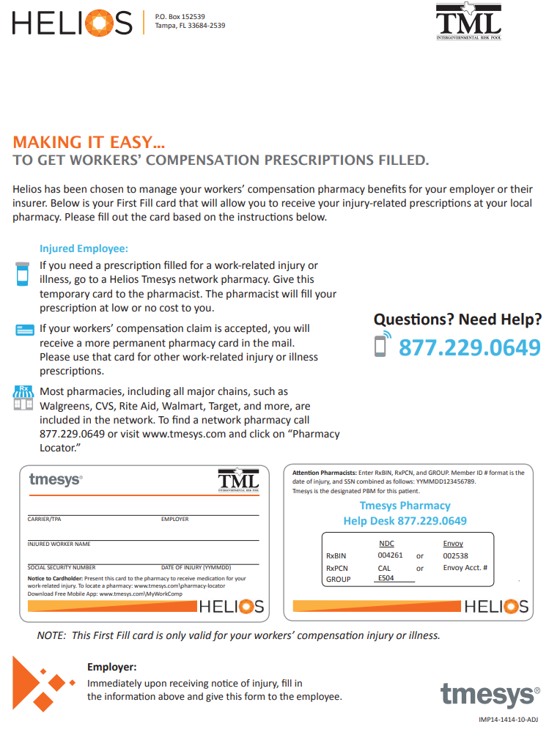
First Fill Cards

Slide 16
Prohibited Actions
It is a violation of law for any employee, supervisor, or manager of the City to discharge or in any other manner discriminate against an employee because the employee files a workers’ comp claim in good faith.

Slide 17
Workers’ Compensation Dispute Resolution
TML has the final say on your claim. You can dispute their decision with them. If you still aren’t satisfied you can appeal to the Texas Dept. of Insurance.

Slide 18
Time Keeping
All time on the day of the injury is regular hours worked
All time on light duty is regular hours worked
Only the time when the employee is completely off work should be entered as WC

Slide 19
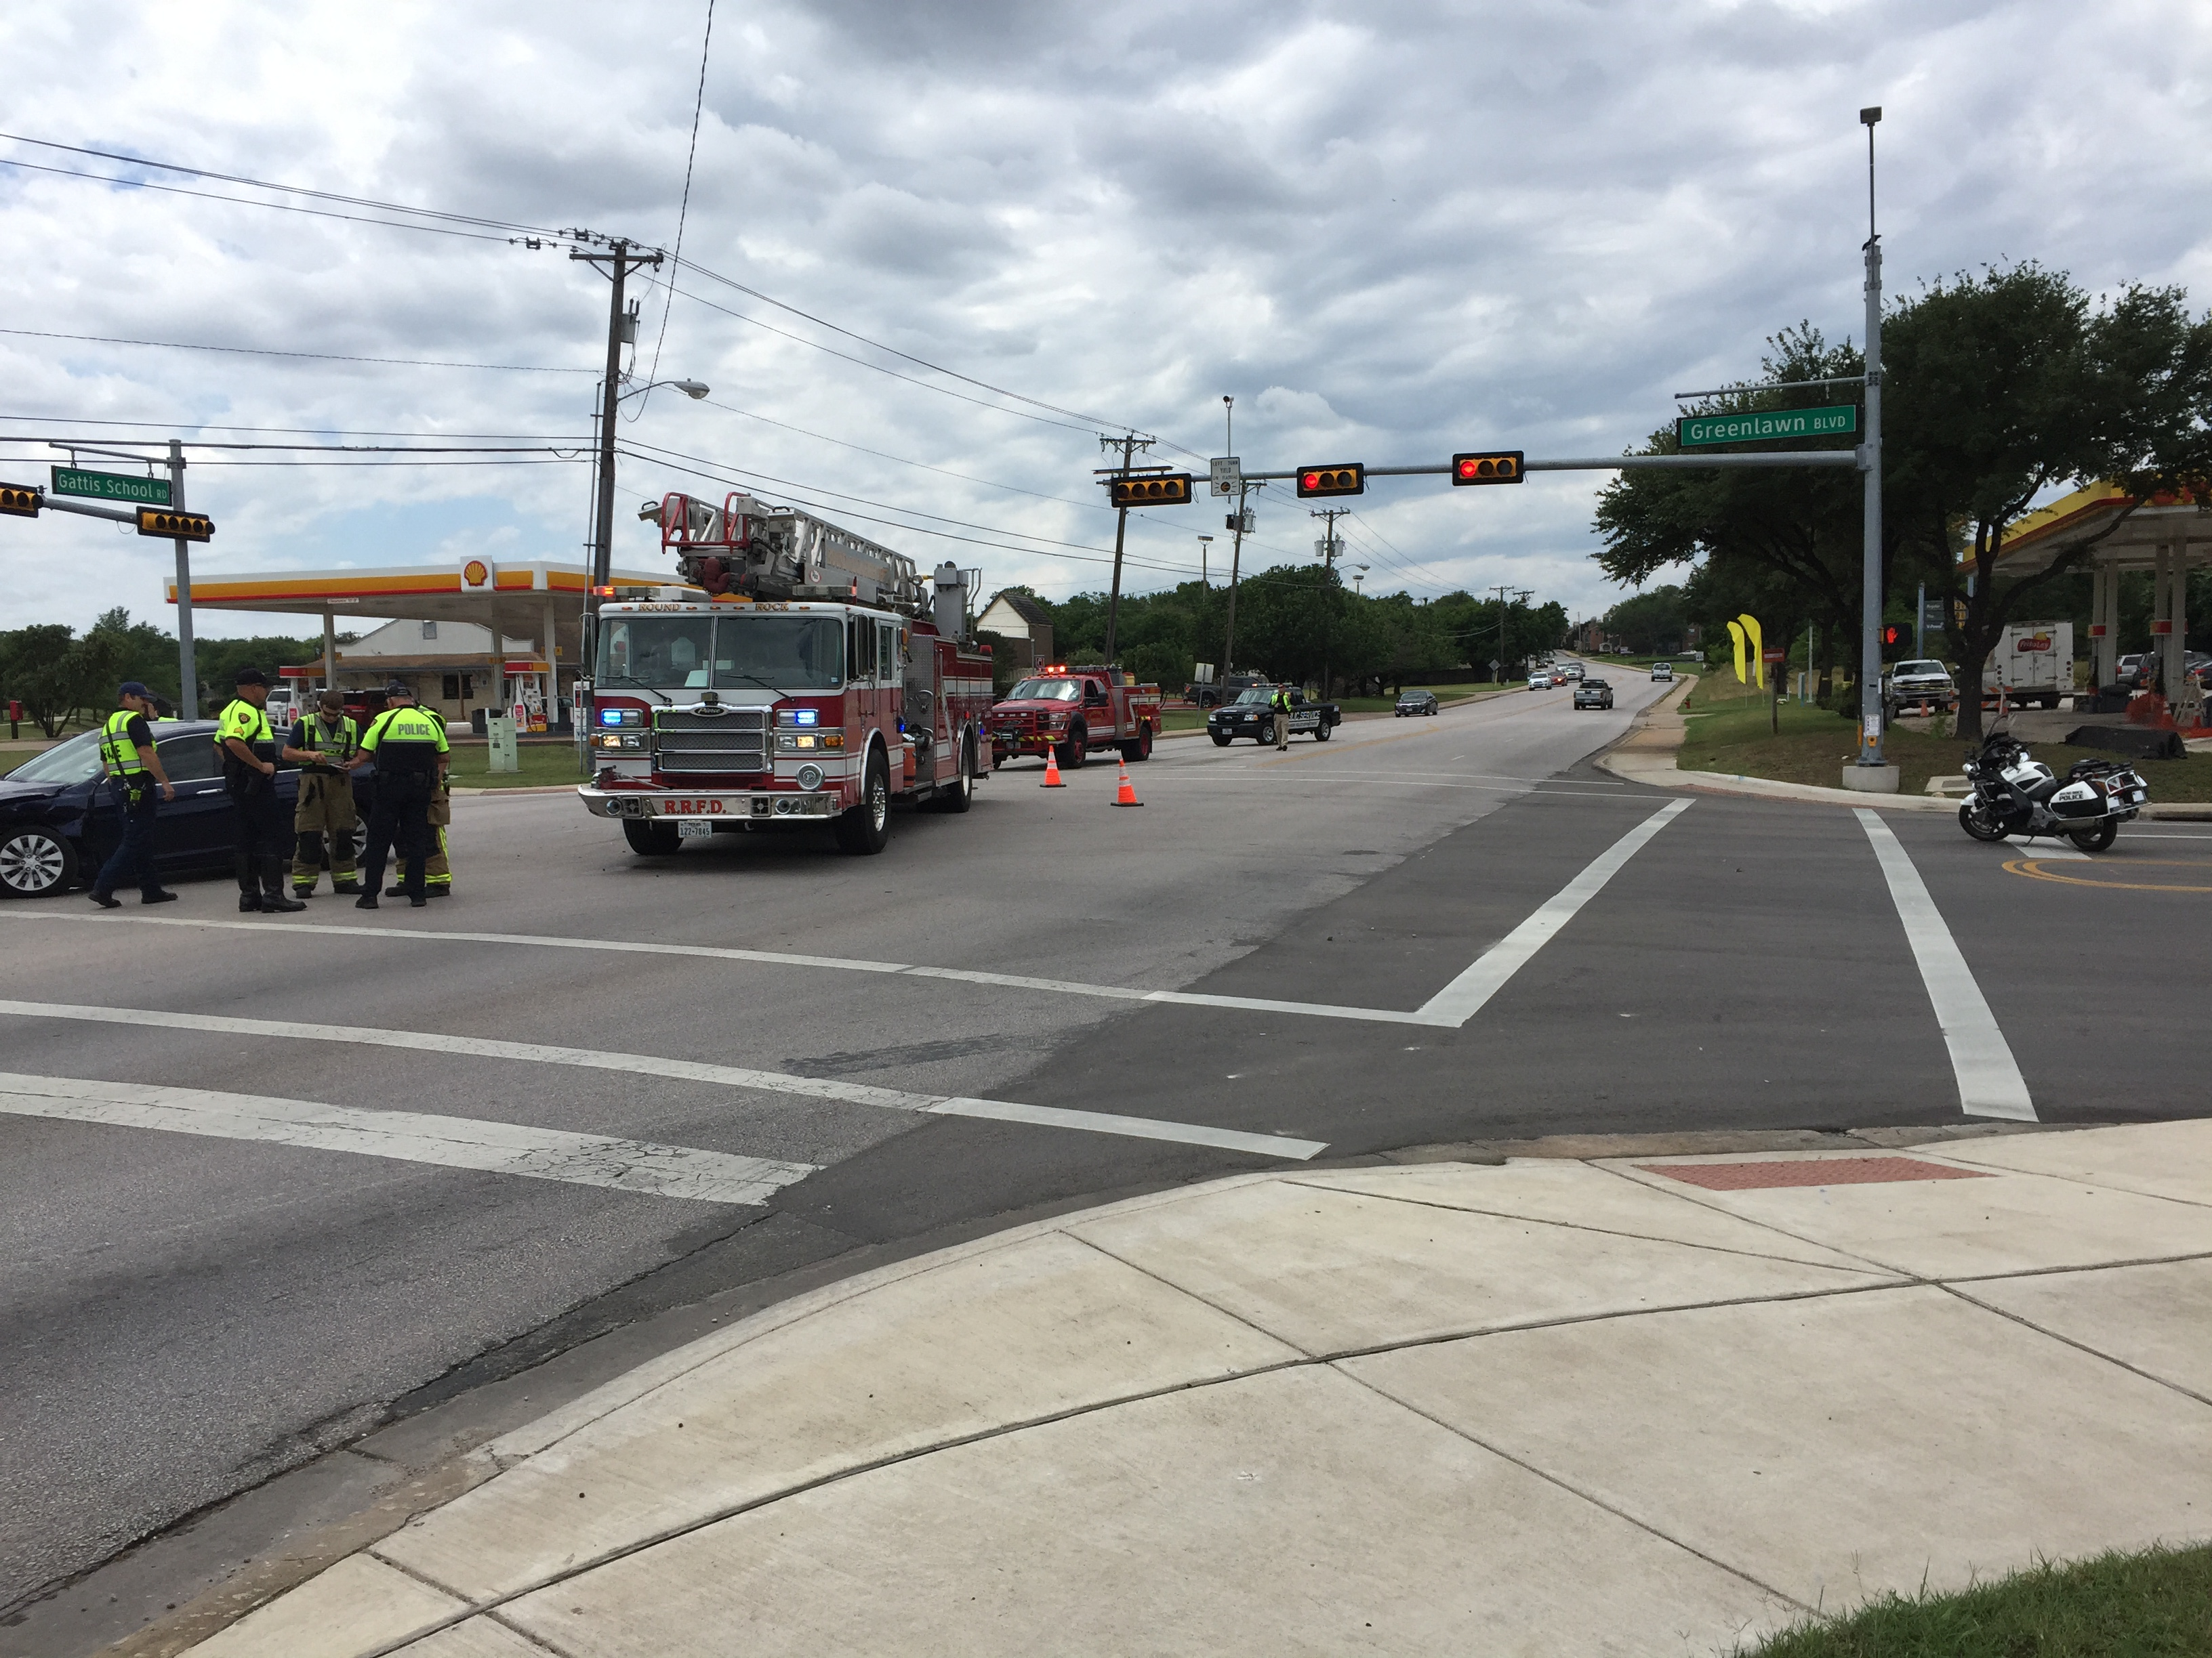
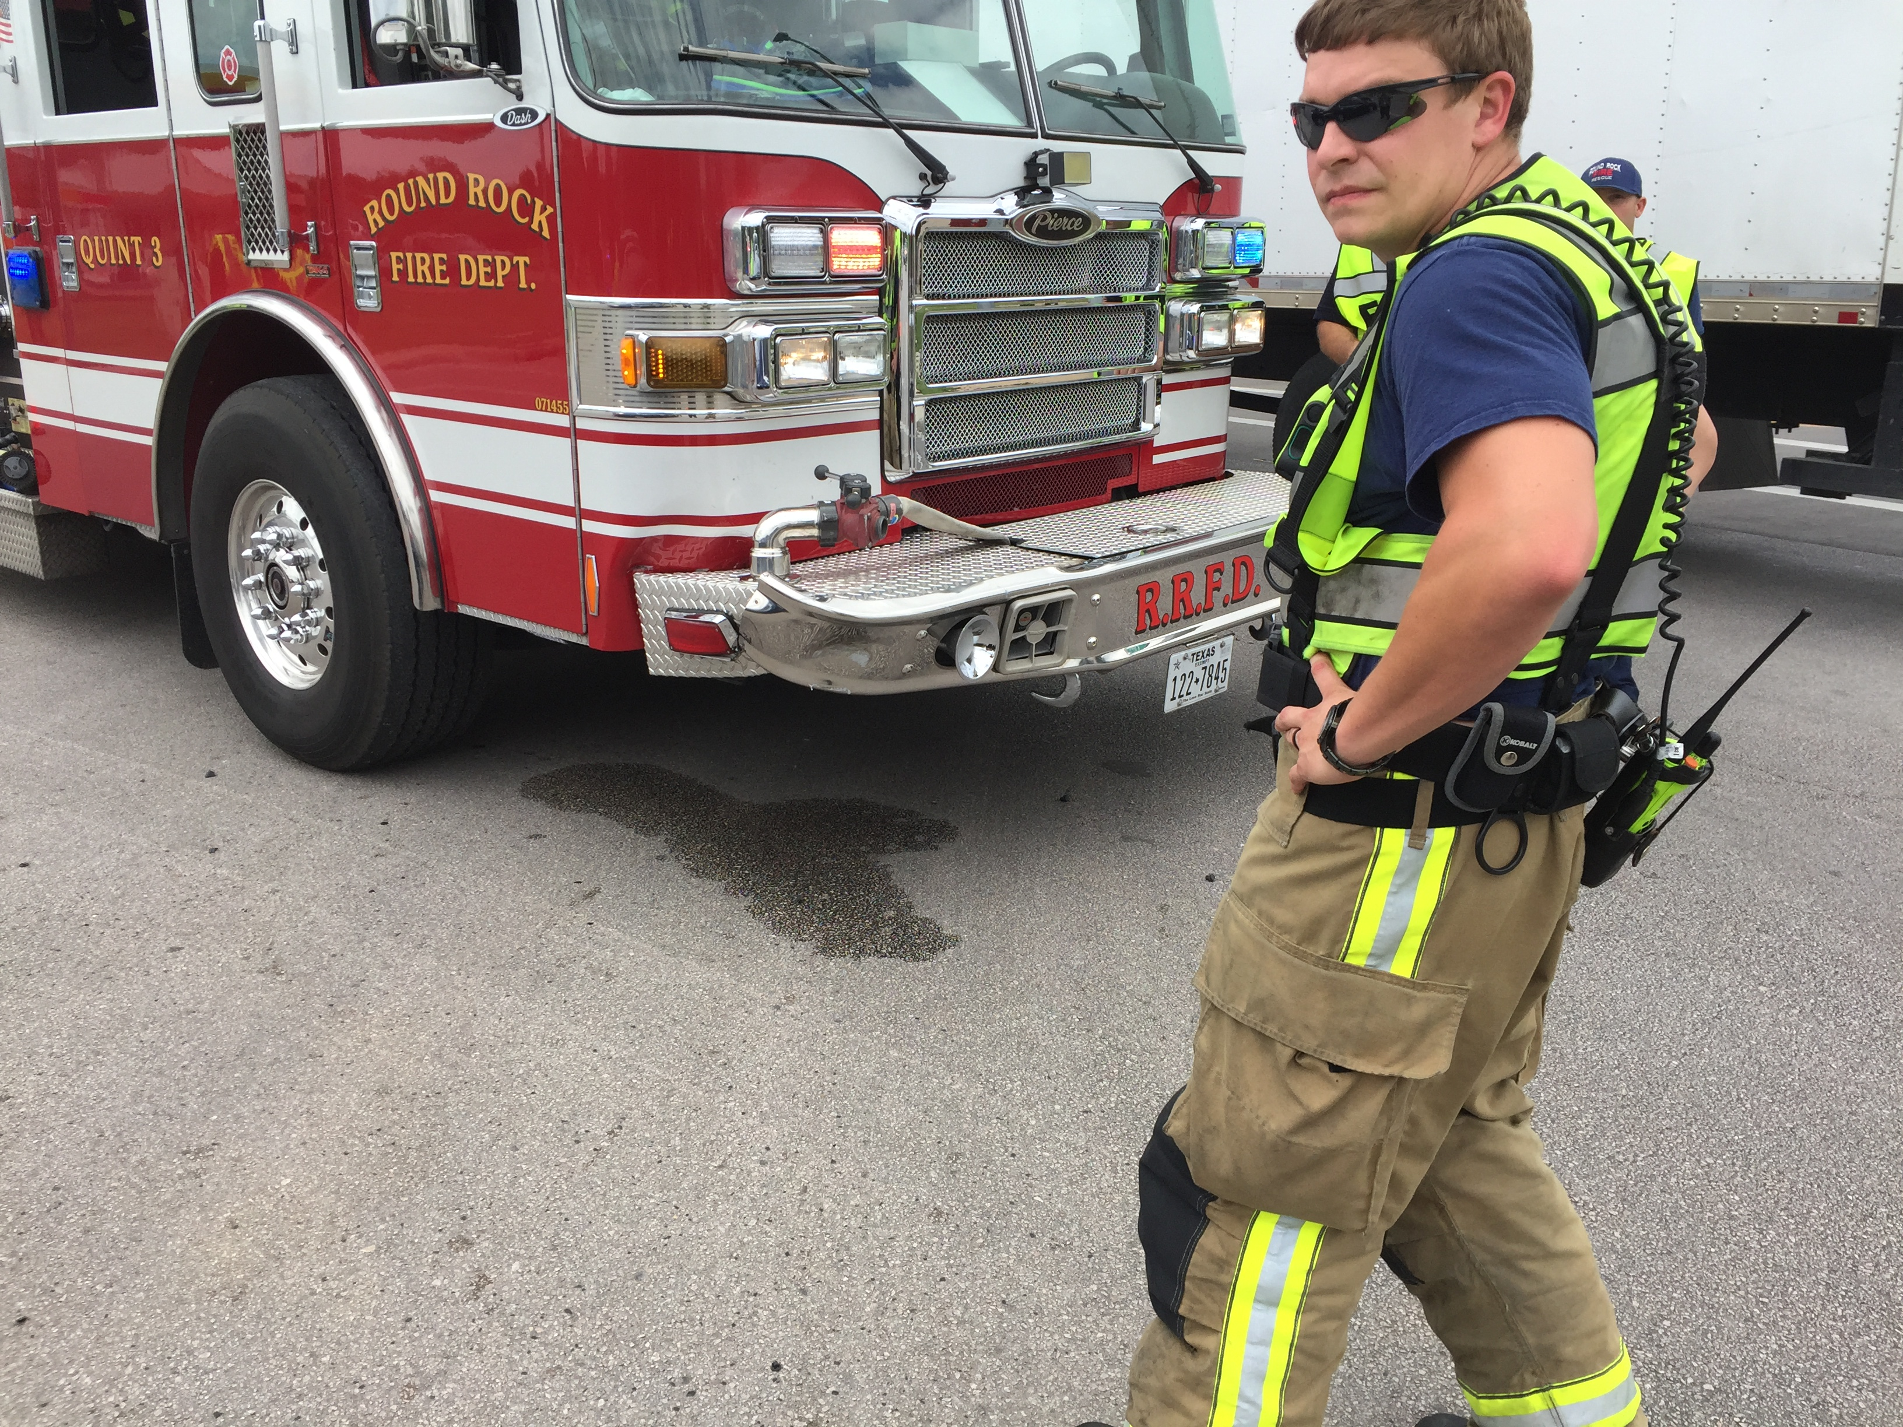
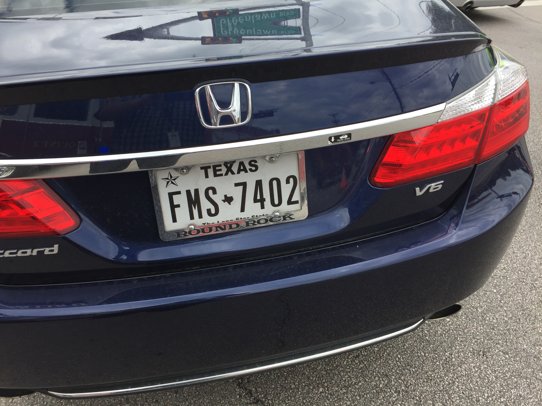
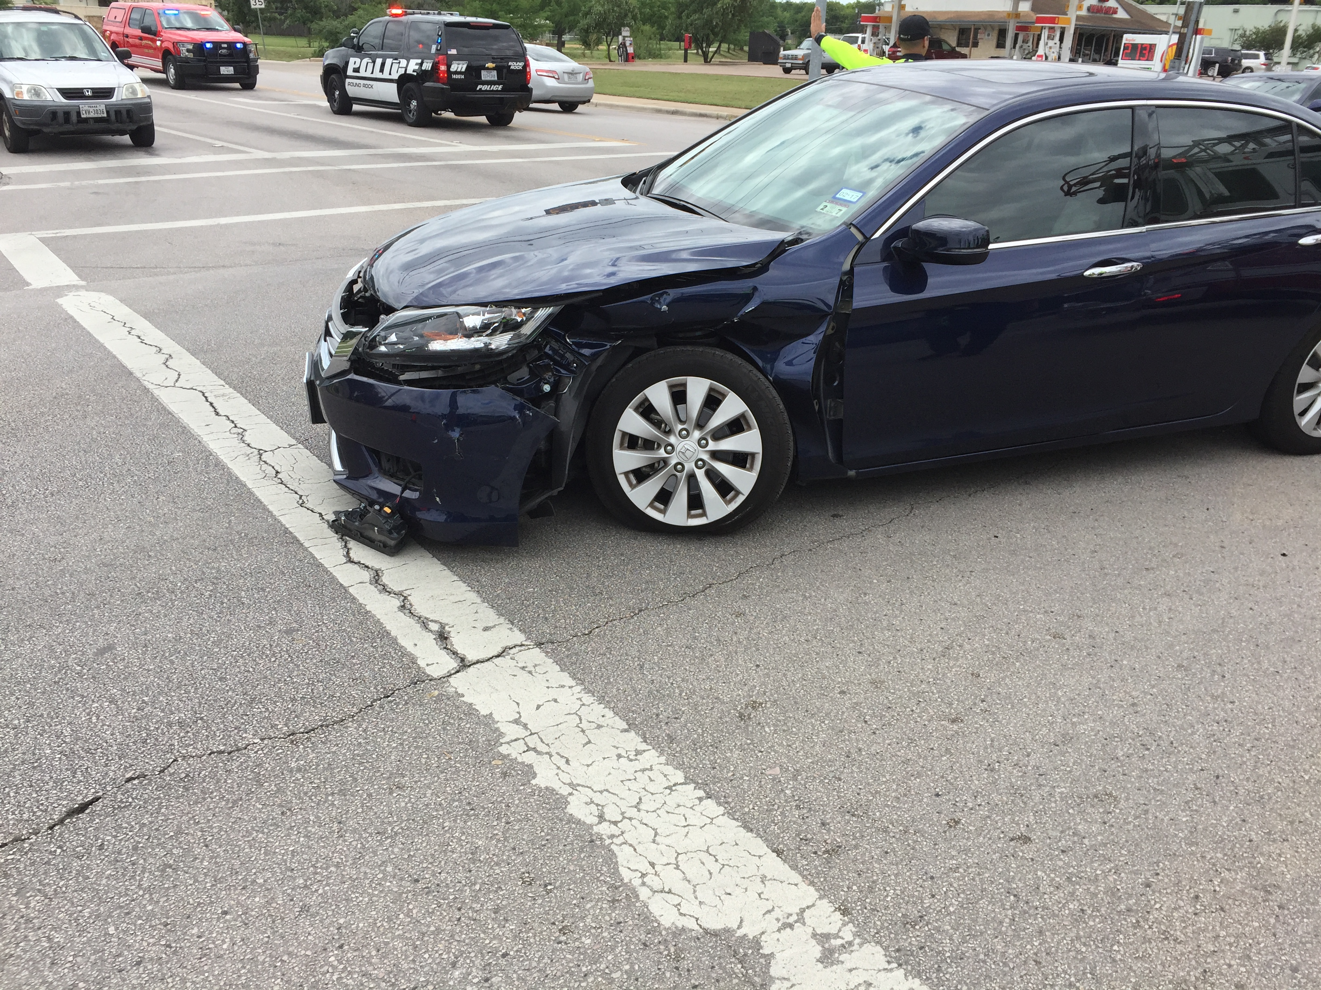
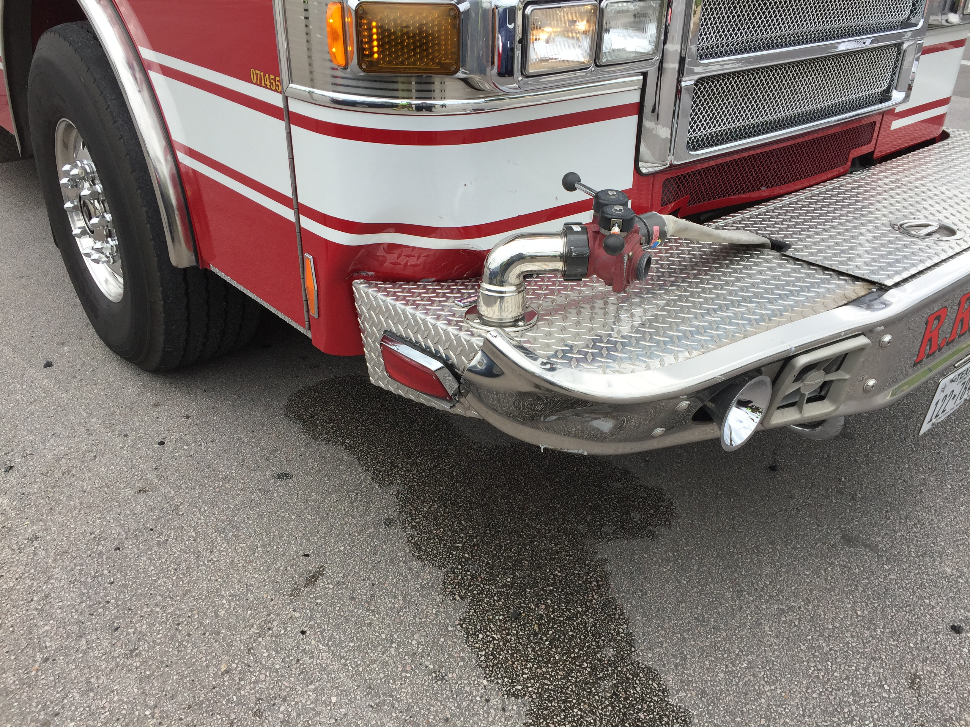
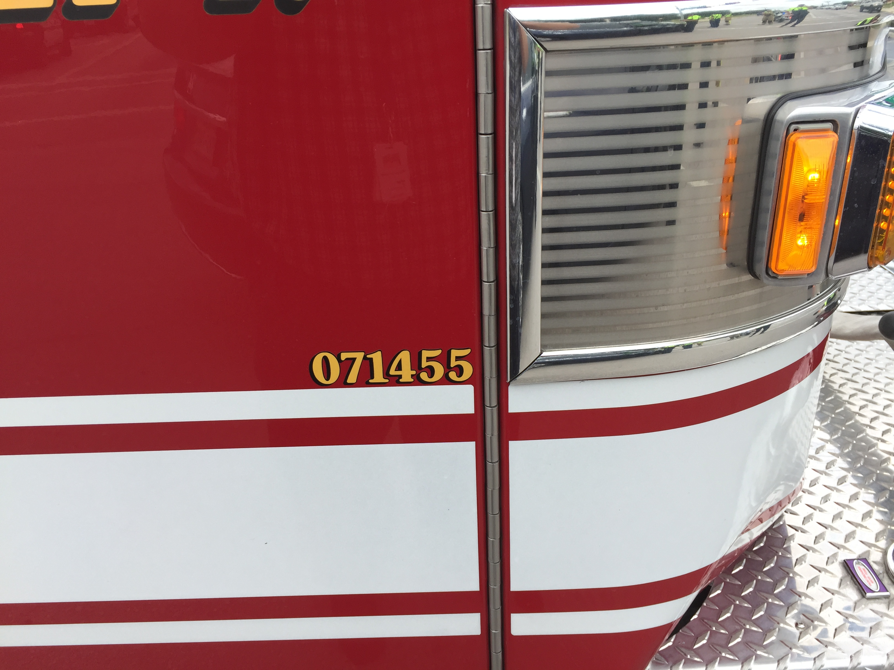
Automobile accidents

Slide 20
Anybody here born AFTER November 7, 2000?
Why is this date important?

Slide 21
Why take driving seriously?
It has been over 25 years since Texas went 24 hours without a motor vehicle fatality
Auto accidents are the leading cause of employee deaths and have been for over 50 straight years
A person dies in an auto accident in Texas every 2 ½ hours
A person is injured an auto accident in Texas every 2 minutes
Texas has led the nation in auto accidents and auto deaths every year for well over a decade

Slide 22
Auto fatalities in the State of Texas
2016 3,794
2017 3,726
2018 3,652
2019 3,610
2020 3,893
2021 4,456
2022 4,410
2023 4,291
2024 4,159
2025 3, 769

Slide 23
Automobile accidents
Make sure you and any passengers are safe
Call 9-1-1
Check on other driver(s)
Do not leave the scene or move vehicle until so advised by a police officer unless you are on I-35, frontage road, or other major thoroughfare and remaining in place would increase you chance of injury
Turn on emergency flashers
Exit the vehicle and move far away from the scene

Slide 24
Automobile accidents
Contact your supervisor
Take photographs
Supervisor contacts Risk Management; myself or Kevin Vaughn
Complete “City of Round Rock-Incident Report Form”
Employee completes all but sections 5(c)-(e)
Supervisor completes remainder of report
Take employee to Rockcare for a drug test
Take the vehicle to Fleet Maintenance for examination

Slide 25
DRUG AND ALCOHOL TESTING

Slide 26
Drug and alcohol testing
The City of Round Rock is committed to maintaining a drug free workplace with zero tolerance for drugs and alcohol
City employees shall not use, possess, sell or provide alcohol or controlled substances to any other employee or to any person while such an employee is on duty
Employees shall not consume alcohol within four hours of reporting for duty, or when on-call

Slide 27
Drug and alcohol testing
Two types of test-urinalysis (UA) and breath alcohol concentration (BAC)
Testing can be:
  Pre-employment-This is taken care of by Human Resources
  Post accident-Any auto accident where the damages may exceed $1,000 and the employee’s vehicle was moving at the time of the accident
  Random-Applies to CDL holders only (For now-currently being modified)
  For cause-Applies to every employee

Slide 28
Drug and alcohol testing
UA Process
Sample is collected at collection center
Sample is secured and sent to lab
Lab examines sample and sends negative test results to myself and Janiqua Mabry
Positive tests are sent to Medical Review Officer (MRO)
  MRO contacts employee to determine reason for the positive test (i.e. valid prescription)
  MRO and only MRO determines if the test is positive
  If employee has a valid prescription, then MRO reports to City that employee was negative
  If the employee does not have a valid prescription MRO certifies as positive

Slide 29
Drug and alcohol testing
BAC process:
Employee taken to Austin Mobile Drug Testing or other approved provider
Employee blows into machine that registers employee’s blood alcohol level
A confirmation test is taken 15 minutes later
Results are given to employee, supervisor and e-mailed to me

Slide 30
Post-accident testing
Employee must immediately notify supervisor, manager or director of any auto/heavy equipment accident
  If the employee cannot reach supervisor, manager or director, then employee may contact any other supervisor in the same department
  If employee cannot reach any of the above, then contact myself or Kevin Vaughn
Supervisor notifies myself or Kevin Vaughn of the accident

Slide 31
Post accident testing
Supervisor makes an initial determination of whether the accident requires testing. What elements are required?
Supervisor immediately transports employee to collection site to be tested for drugs and/or alcohol
If the collection site is closed, go the intranet, http://websrvr/Portal/portalpages/hrhse.htm and contact the after-hours collection company (Austin Mobile Drug Testing)
When must post accident testing occur? Within 2 hours of the accident
If you cannot meet the timelines, you must document WHY?
Remember, employee medical treatment comes first, testing comes second!
Employee does not resume driving until test results come in!!!

Slide 32
Reasonable suspicion
Procedure:
  Reasonable suspicion applies to all employees, not just CDL drivers
  Any supervisor may make a reasonable suspicion determination on any employee, not just their own employees
  The supervisor shall immediately contact HR when observing suspicious behavior
  If approved to test, collection must take place within 2 hours of the observation
Prohibitions:
  The employee shall not be allowed to return to work for 24 hours
  Employee is not allowed to return to driving until the test results are received

Slide 33
Positive tests and discipline
HR will notify the employee’s supervisor of any positive test results and will work with department staff to determine appropriate discipline
Levels of Positive Results
  Employees that test positive for blood alcohol with a level of .02-.04 (0.0 for Police and Fire)
  Employees that test positive for blood alcohol with a level of .04 and above
Types of Discipline
  Employees that refuse to take a drug test or adulterate a specimen will be terminated immediately
  Progressive discipline up to and including termination and/or disciplinary probation
  At a minimum, employees will be given either a demotion of one pay grade for a period of six months, or unpaid suspension for 2 weeks, at the discretion of the department director after consultation with the HR
  During the period of demotion, the employee will not be allowed to operate a motor vehicle until approved by the substance abuse professional (SAP) and HR
  Employee must complete the treatment plan recommended by the SAP
  Continued testing as indicated by SAP

Slide 34
Questions?

