Slide 1
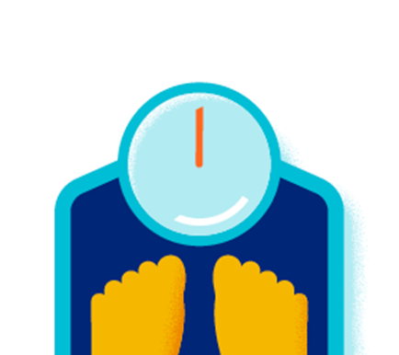

Healthier Weight
Wednesday, February 11th, 2026
11:30 a.m.
Open to all City of Round Rock employees
Lunch provided
Click here to register
Participants will:
Learn about the risks of obesity and benefits of a healthier weight and how health may increase happiness
Review ways to evaluate a healthy weight
Understand the components of weight loss
Review ways to address factors contributing to unhealthy weights such as eating habits, physical activity, stress, sleep and more
Live Session
301 W Bagdad Avenue, Building 2, Round Rock, TX, 78664
Allen R. Baca Center, Baca Meeting Room 03
Questions?
Contact UHC Health Engagement Coach James Williamson
james_Williamson@uhc.com

